Slide 1
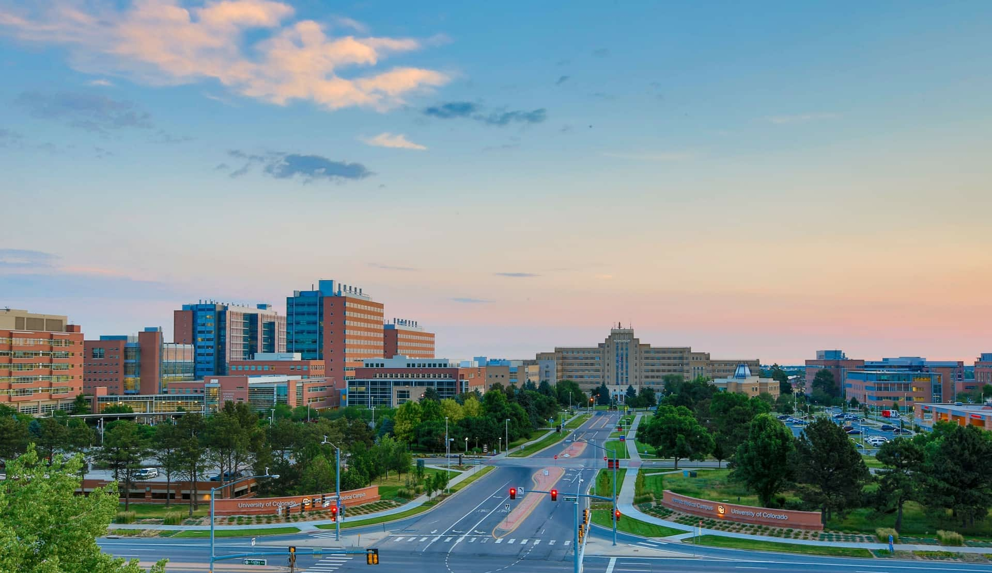
Large Language Models
Jayashree Kalpathy-Cramer, PhD
May 3rd, 2025

Slide 2
Agenda
10:30 – 10:35am | Welcome and introductions
10:35 – 10:55am | Introduction to LLMs, how they work and their limitations.
10:55 – 11am | Hands-on Lab: How LLMs could be used for research
11am – 11:20am | Exercise 1: Using ChatGPT to extract data from a screenshot
11:20 – 11:40am | Exercise 2: Simple data analysis like regression, plotting
11:40 – 11:55am | Exercise 3: Using NotebookLM for audio summarization of a DUA
11:55am – 12pm | Session wrap-up

Slide 3




How familiar are you with AI, specifically LLMs
Do not edit How to change the design
The Slido app must be installed on every computer you’re presenting from

Slide 4
What do you use AI for today?

Slide 5
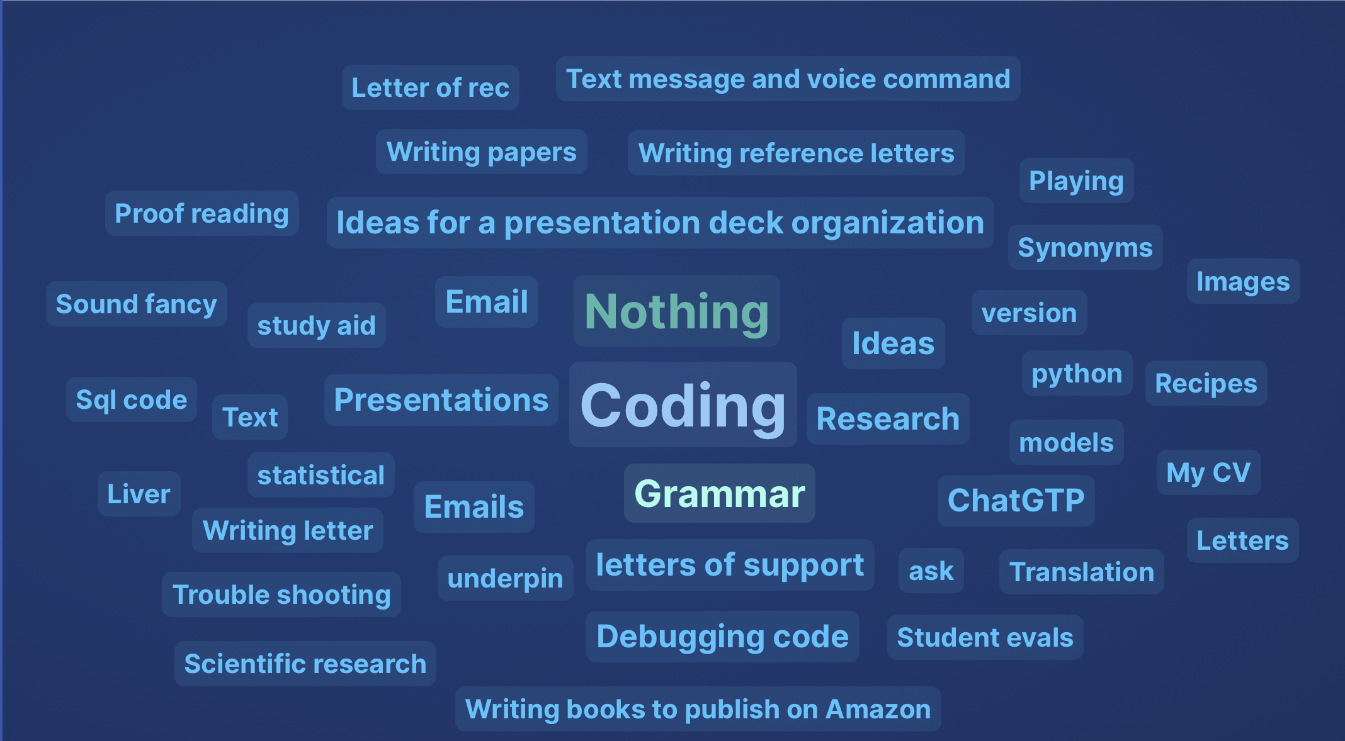
What do you use AI for today?

Slide 6
How often do you use AI?

Slide 7
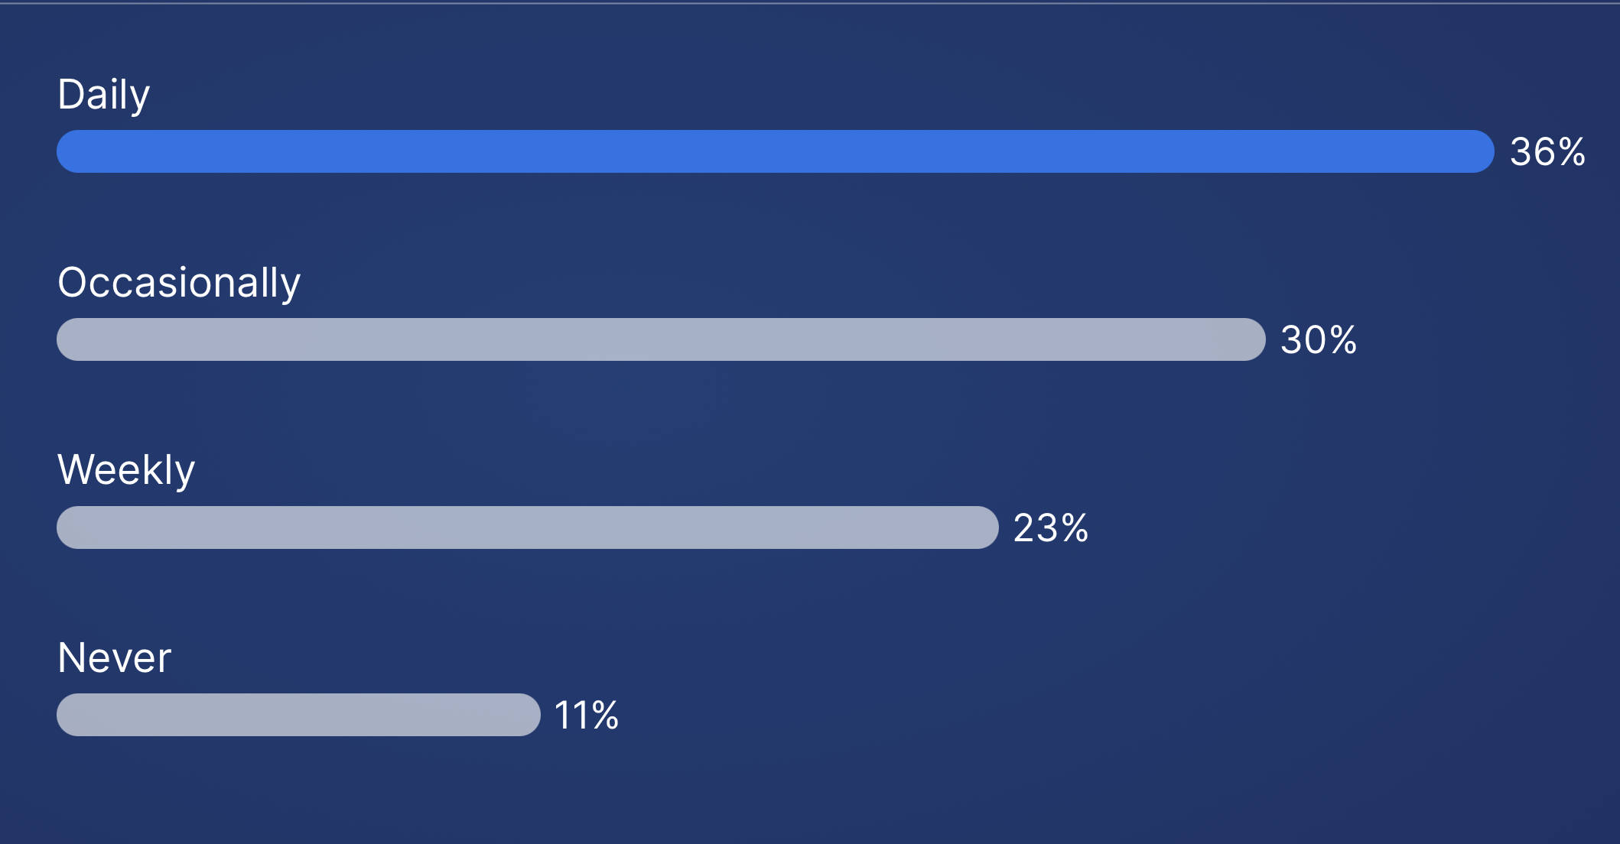
How often do you use AI?

Slide 8
What have you found most frustrating about using AI?

Slide 9
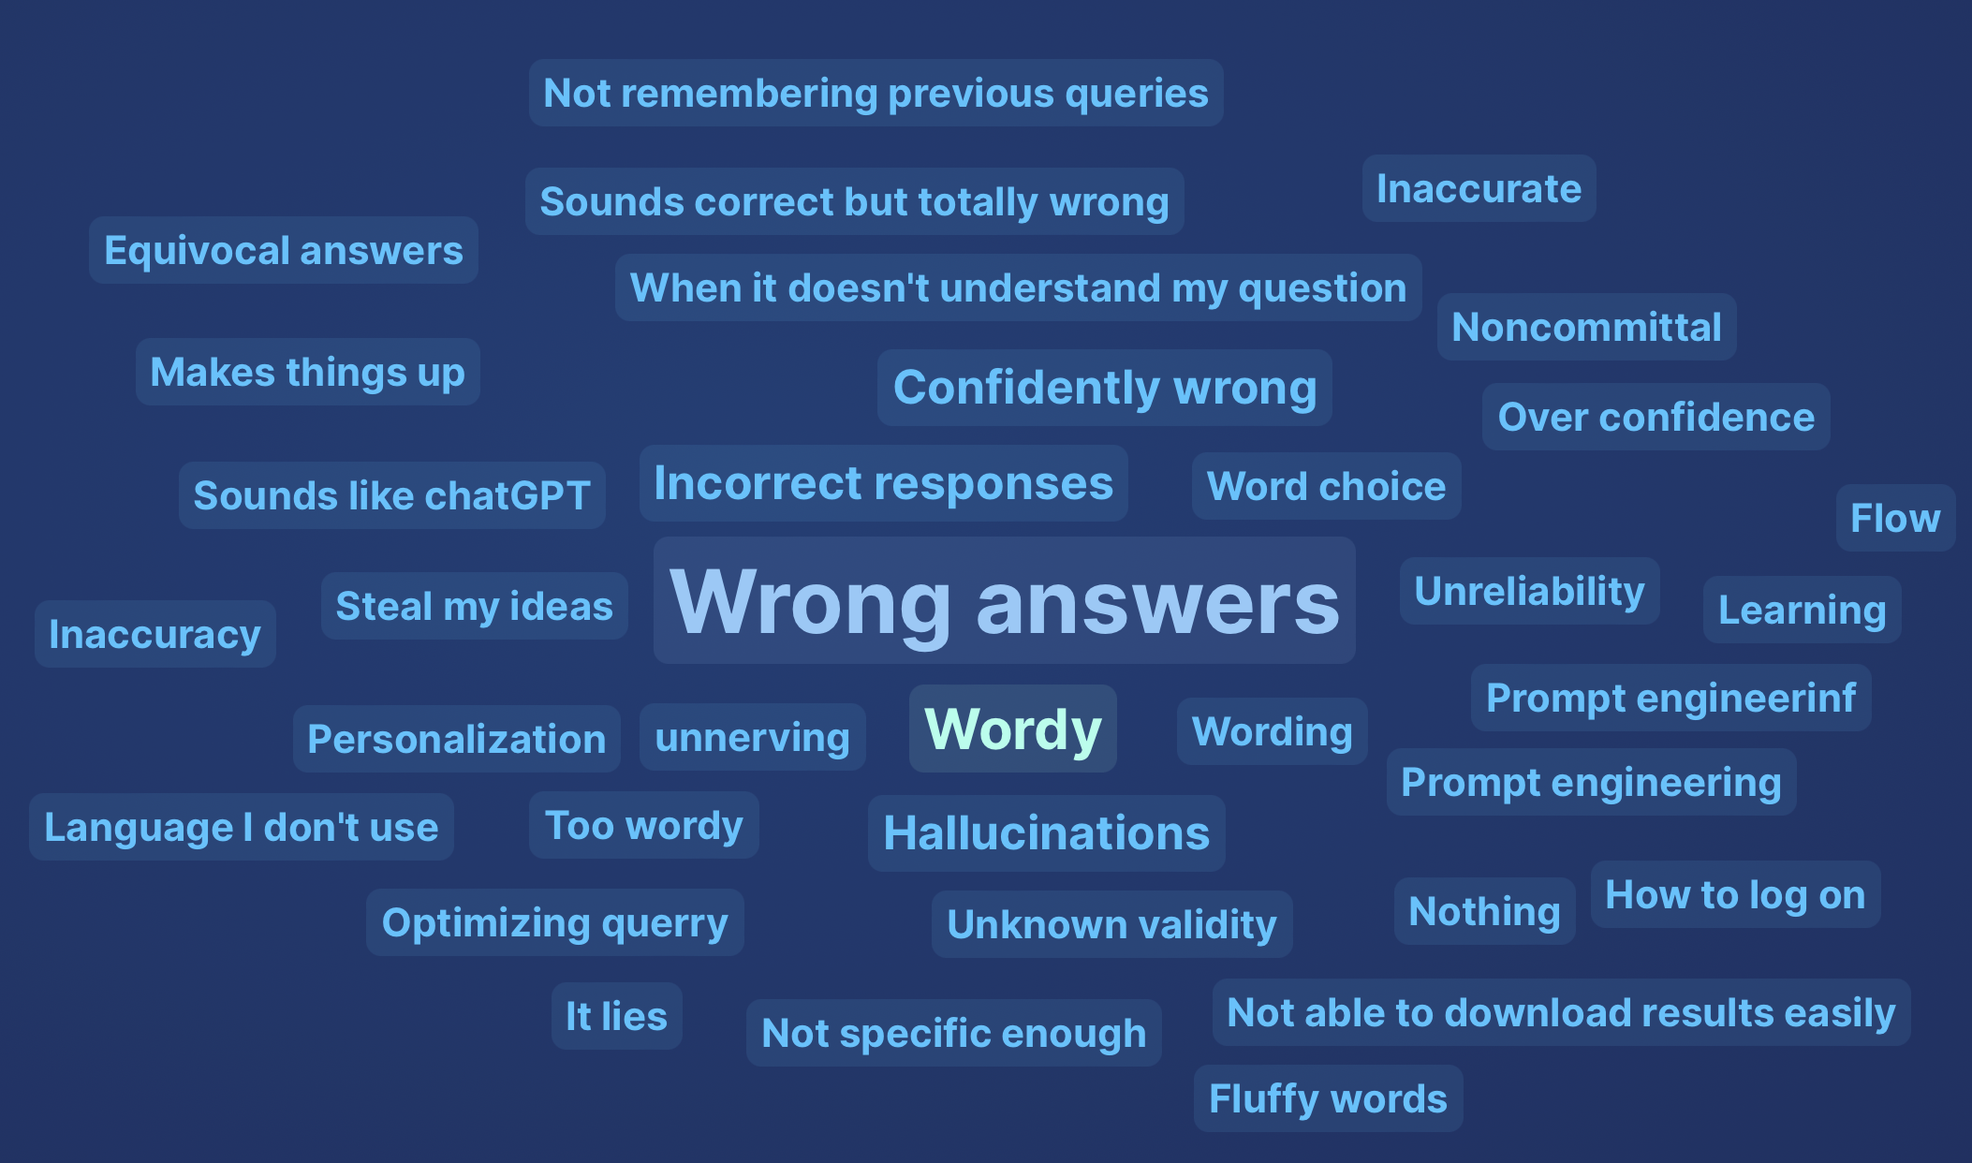
What have you found most frustrating about using AI?

Slide 10
Which of the following have you used AI for?

Slide 11
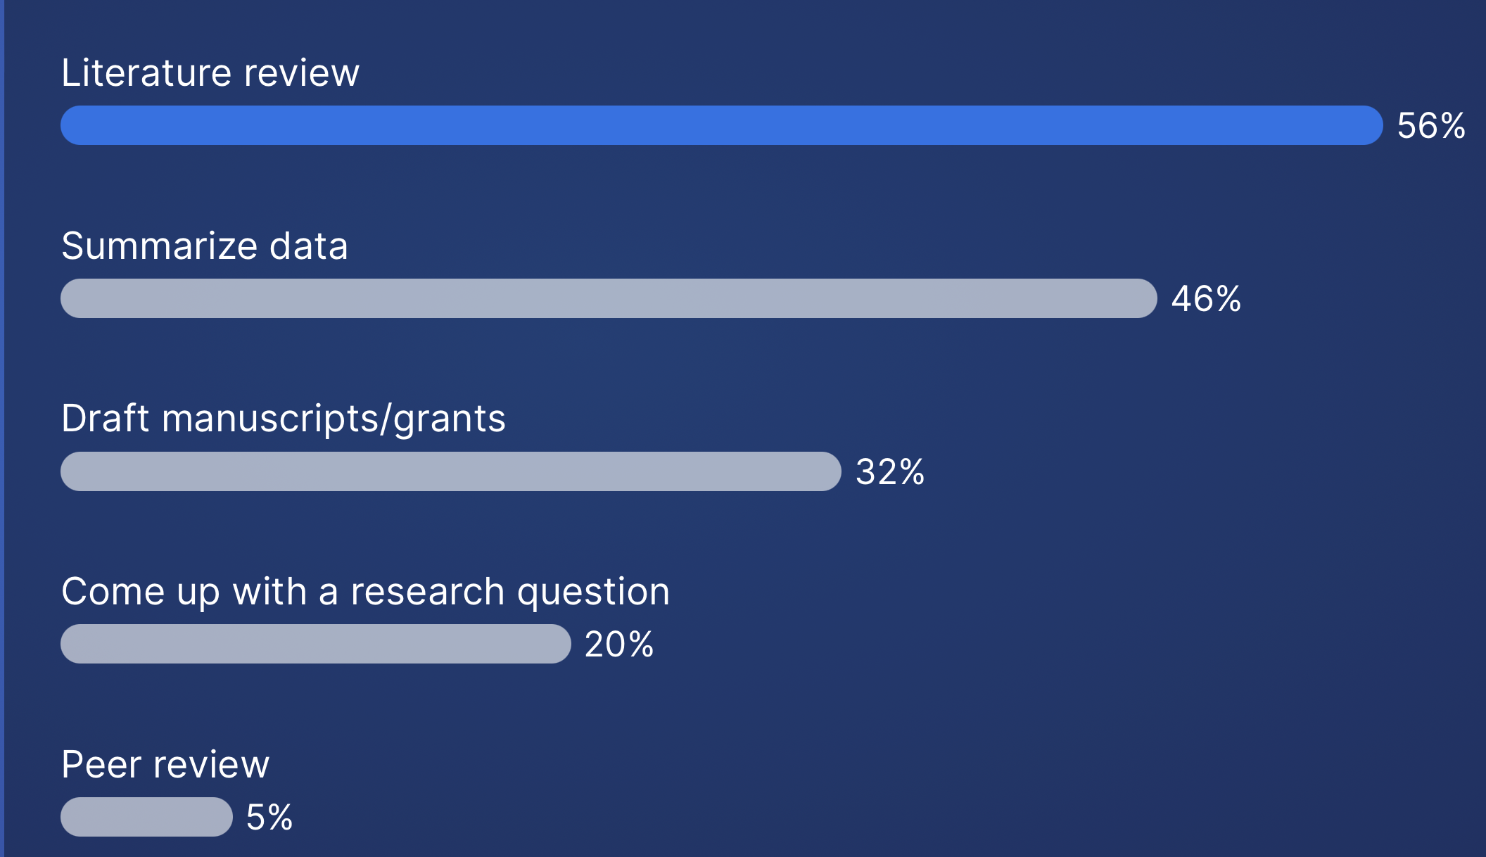
Which of the following have you used AI for?

Slide 12

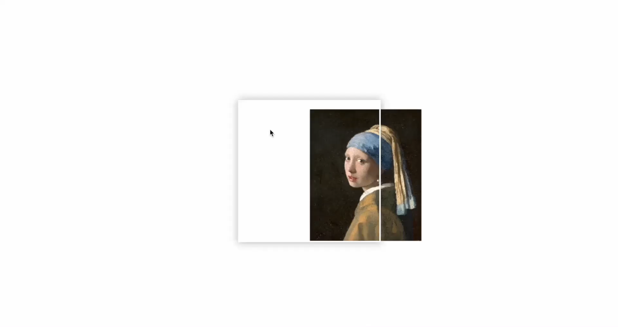

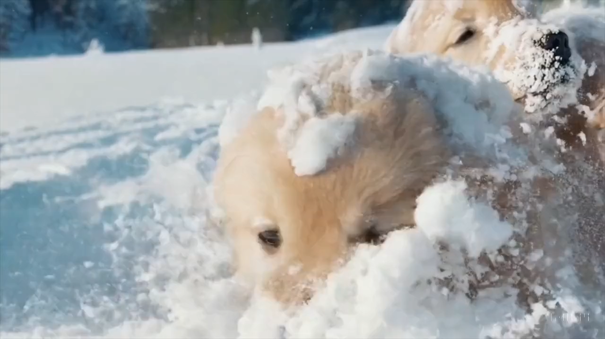
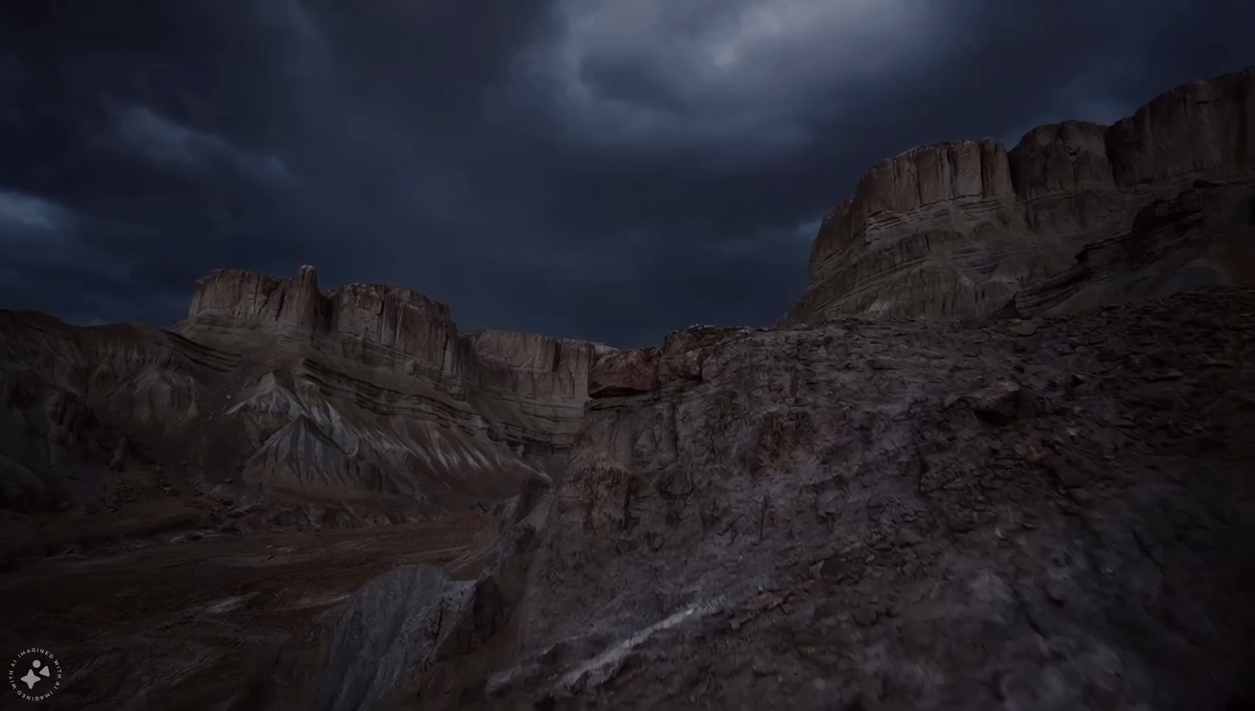

What is Generative AI?
ChatGPT: “a subset of artificial intelligence that can create new content such as text, images, or even molecular structures, based on patterns learned from vast amounts of data. Unlike traditional AI, which is typically rule-based or focused on classification tasks, generative AI models generate original outputs [that can mimic human-like creativity]. In healthcare, genAI could be used for generating clinical summaries, diagnostic suggestions, personalized treatment plans, or even simulating molecular interactions for drug discovery
Gemini: “Generative artificial intelligence (AI) is a type of AI that can create new content, such as text, images, videos, music, and code.”
EXAMPLES
Text (LLMs): ChatGPT, Gemini, Llama
Images: DALL-E, Midjourney
Videos: Sora, Meta Movie Gen
Notes:
Generative AI: output can be any word, pixel value, frame
Discriminative: output can only assume a value within a (mostly) pre-defined set
Text:
Given a movie review, is the sentiment positive or negative?
Given a clinical note, what ICD codes should be associated with it?
Images:
Given a photograph, does it include a dog, cat, or horse?
Given a Fundus Auto Fluorescence image, does the patient have geographic atrophy?
Sora: “A litter of golden retriever puppies playing in the snow. Their heads pop out of the snow, covered in.”
Meta Movie Gen: “Thunder cracks loudly, with an orchestral music track.”

Slide 13
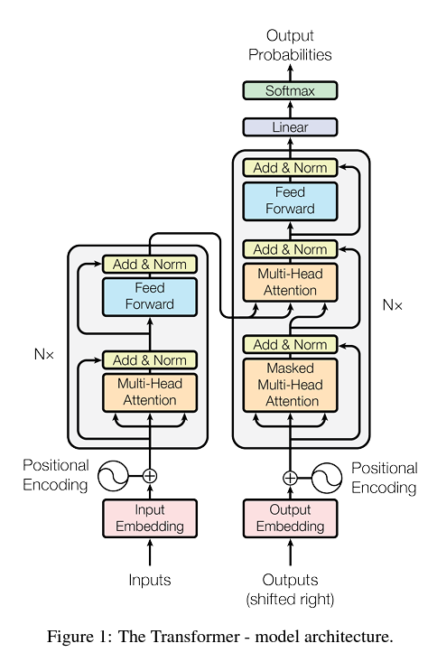
Why NOW?
Why are we talking about Generative AI now?
IMPORTANT CONTRIBUTORS
Lots of data available from the Internet (models can learn from these)
Technology advances: fast GPUs/TPUs with large memories (we can computationally train models)
MAIN CONTRIBUTOR
The Transformer architecture from “Attention is all you need” [1]
Able to model long-term dependencies in sequences (e.g., words in a sentence)
Able to parallelize computations (i.e., multiple computations at once), resulting in fast(er) training
Vaswani, A. "Attention is all you need." Advances in Neural Information Processing Systems (2017).

Slide 14
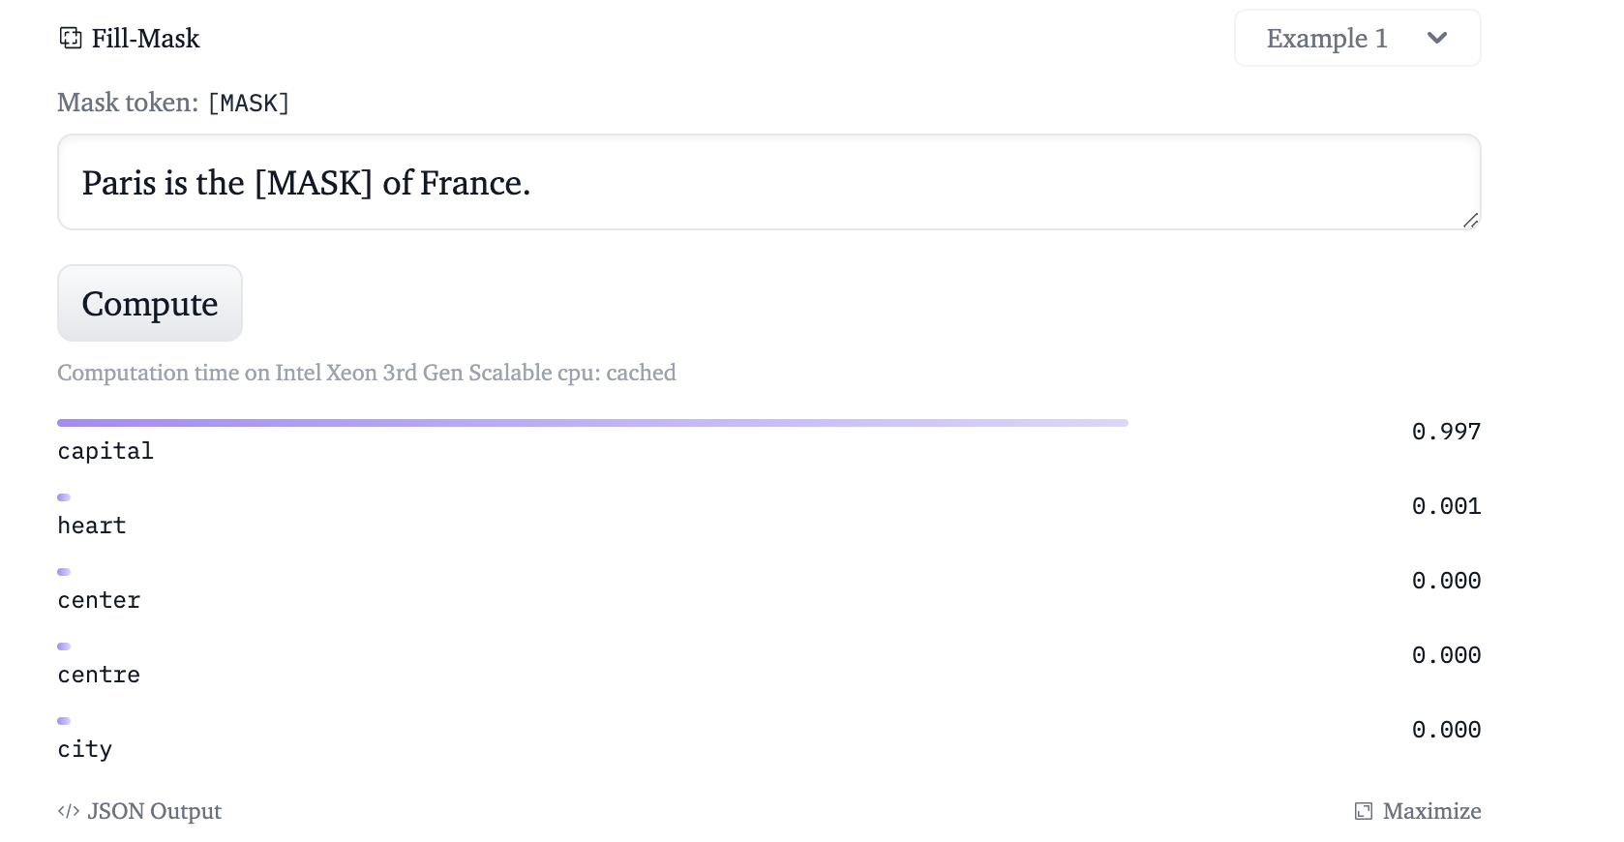
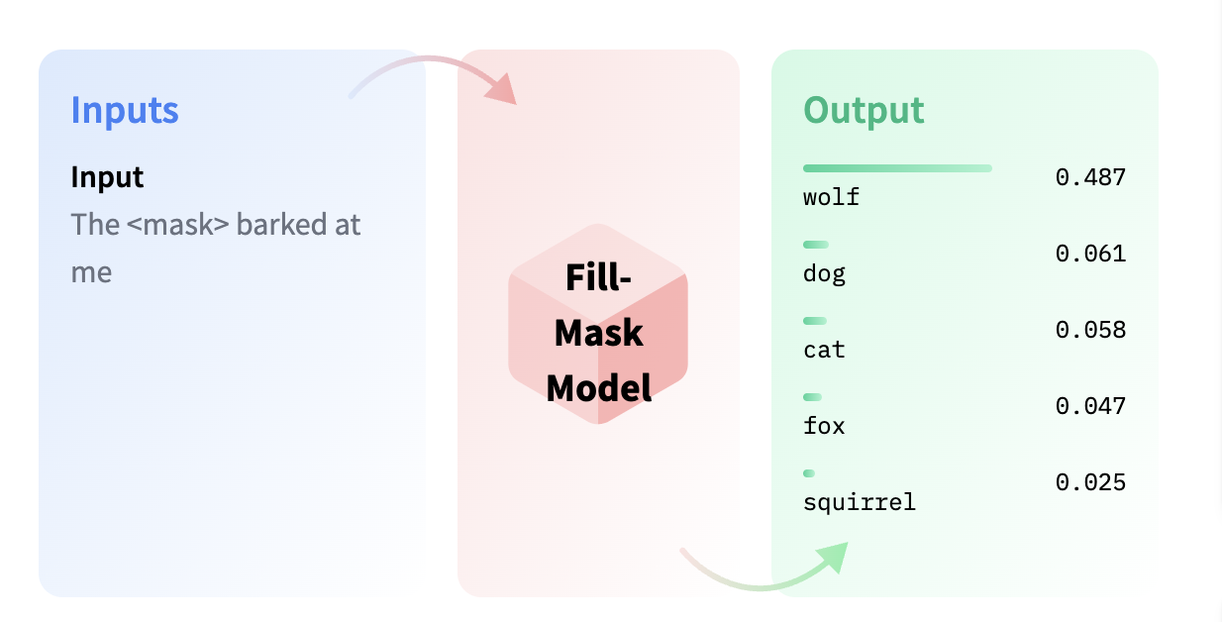
Training large language models: curating large datasets, preprocessing (tokenizing), pre-training, fine-tuning
Large Language Models
https://huggingface.co/tasks/fill-mask

Slide 15
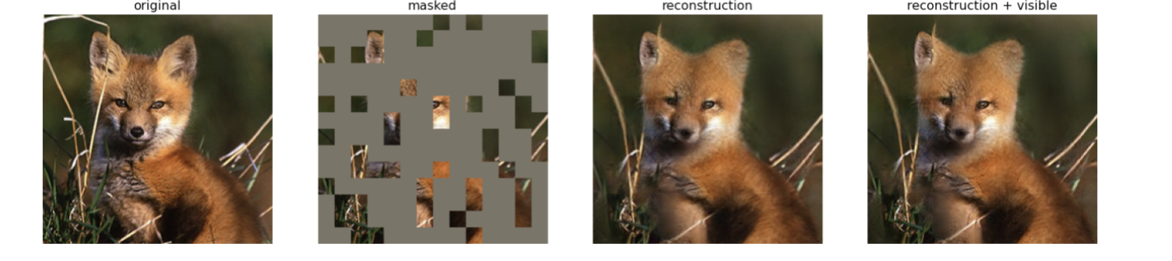
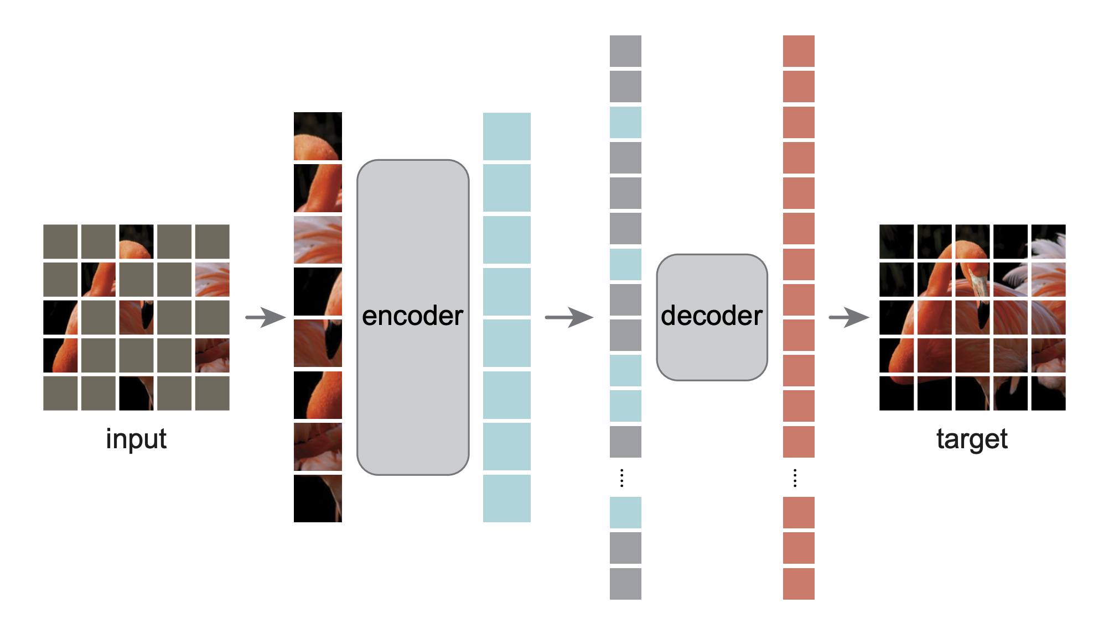
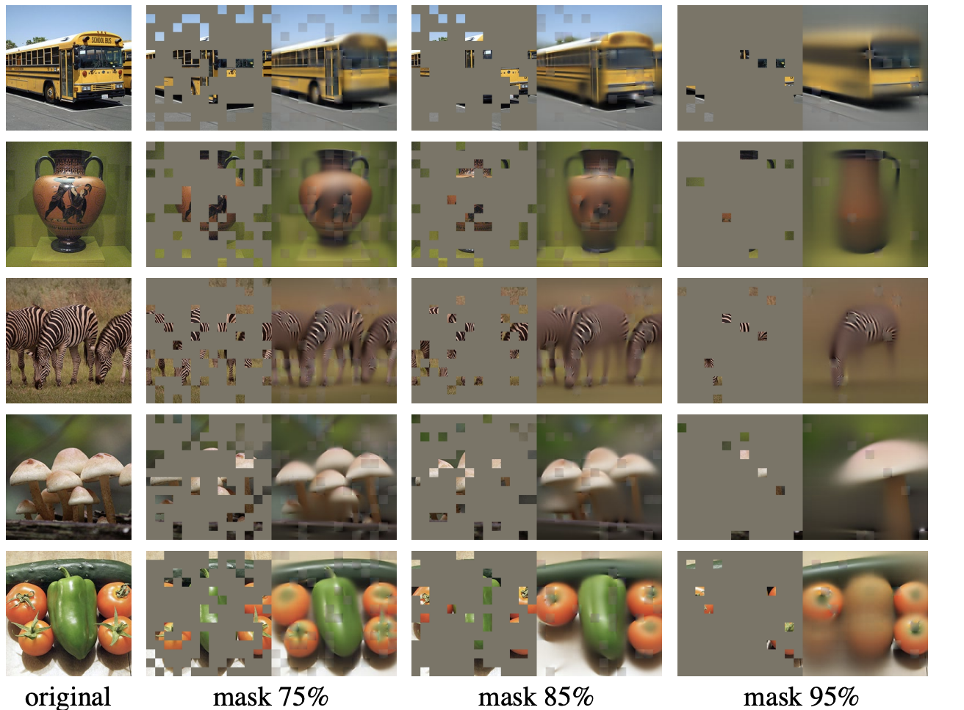
Self supervised Learning (Vision)
Masked auto-encoder
He et al, 2021, https://arxiv.org/pdf/2111.06377.pdf

Slide 16
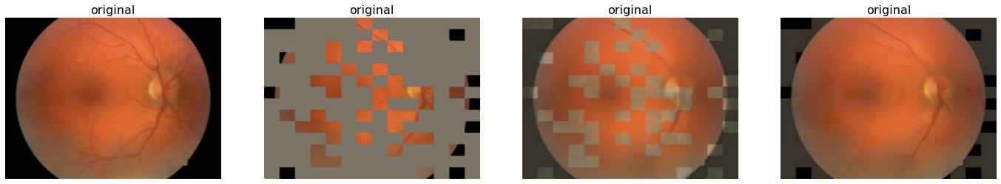
... In Medical Imaging

Slide 17
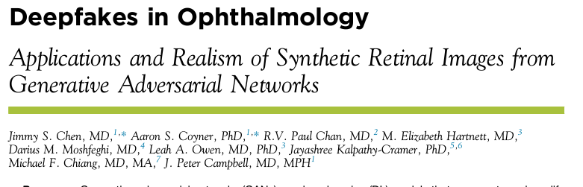
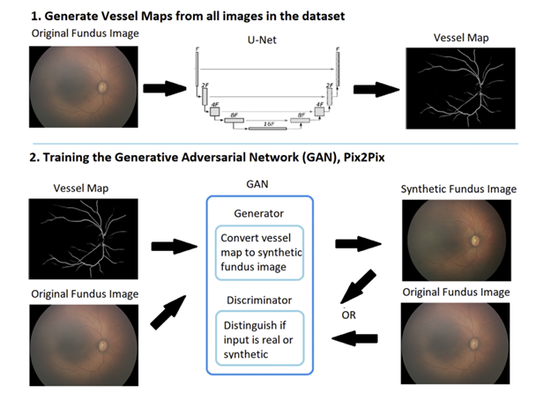
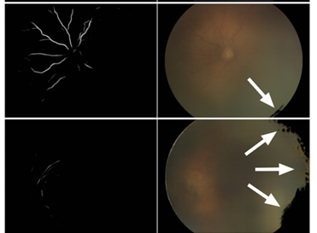
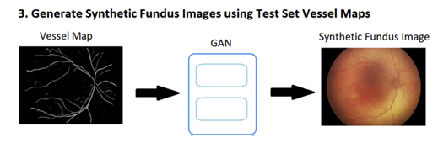
Generating realistic synthetic images is possible
Fails!
Notes:
We should that it is possible to generate synthetic images in ophthalmology

Slide 18
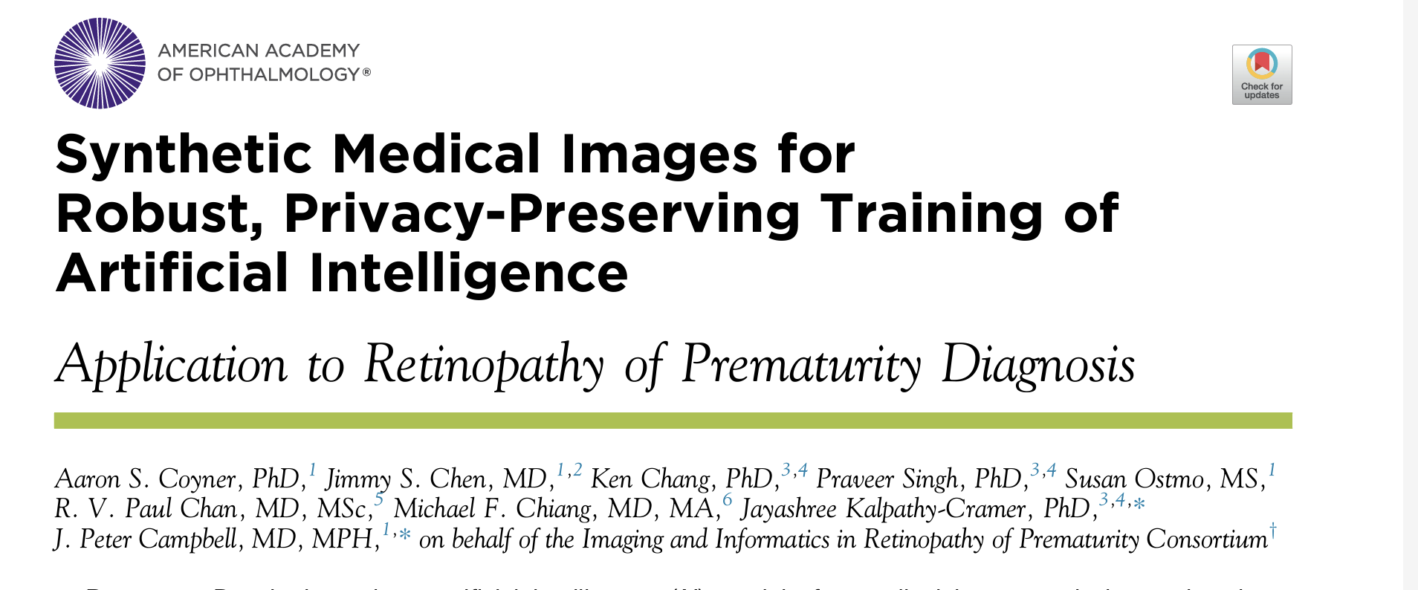
And can be used to train AI models
“Synthetic datasets maybe useful for training robust medical AI models.”

Slide 19
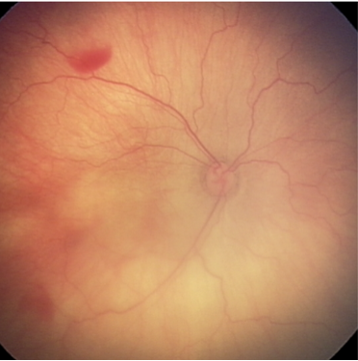
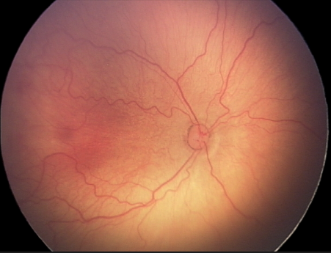
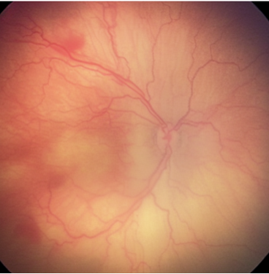
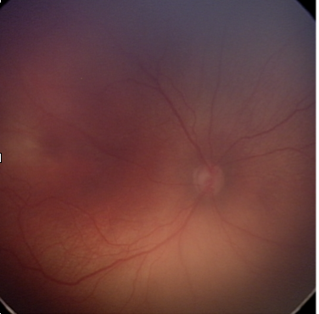
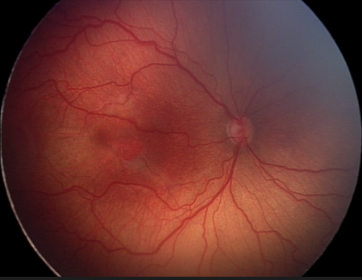
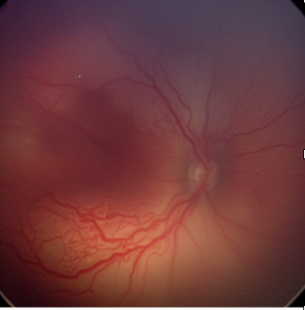
Can you predict out the patient’s future given the past?
Past
True future
Generated future

Slide 20

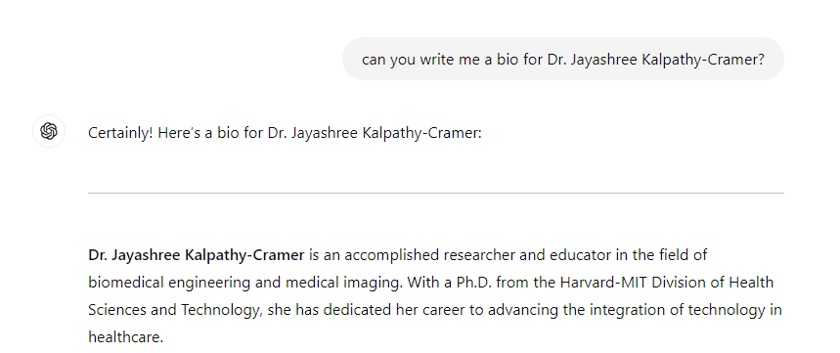
Risks of Generative AI
GenAI is remarkable, but it is not perfect!
INCORRECT GENERATIONS
Animals or people can spontaneously appear, especially in scenes containing many entities.
HALLUCINATIONS
Hallucinations refer to generated content that is untrue
GenAI models tend to confidently hallucinate
Notes:
From SORA
Prompt: Five gray wolf pups frolicking and chasing each other around a remote gravel road, surrounded by grass. The pups run and leap, chasing each other, and nipping at each other, playing.
Weakness: Animals or people can spontaneously appear, especially in scenes containing many entities.

Slide 21
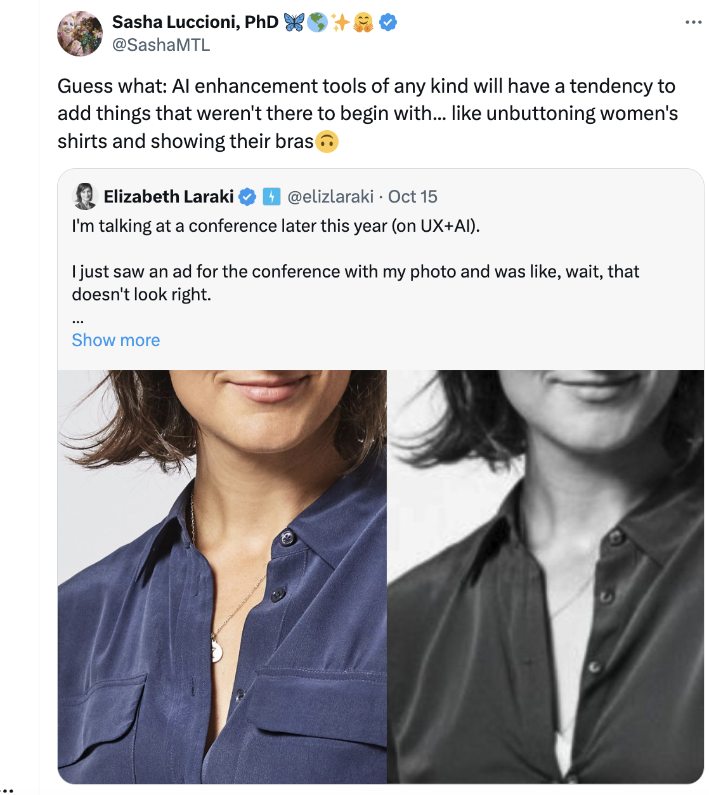
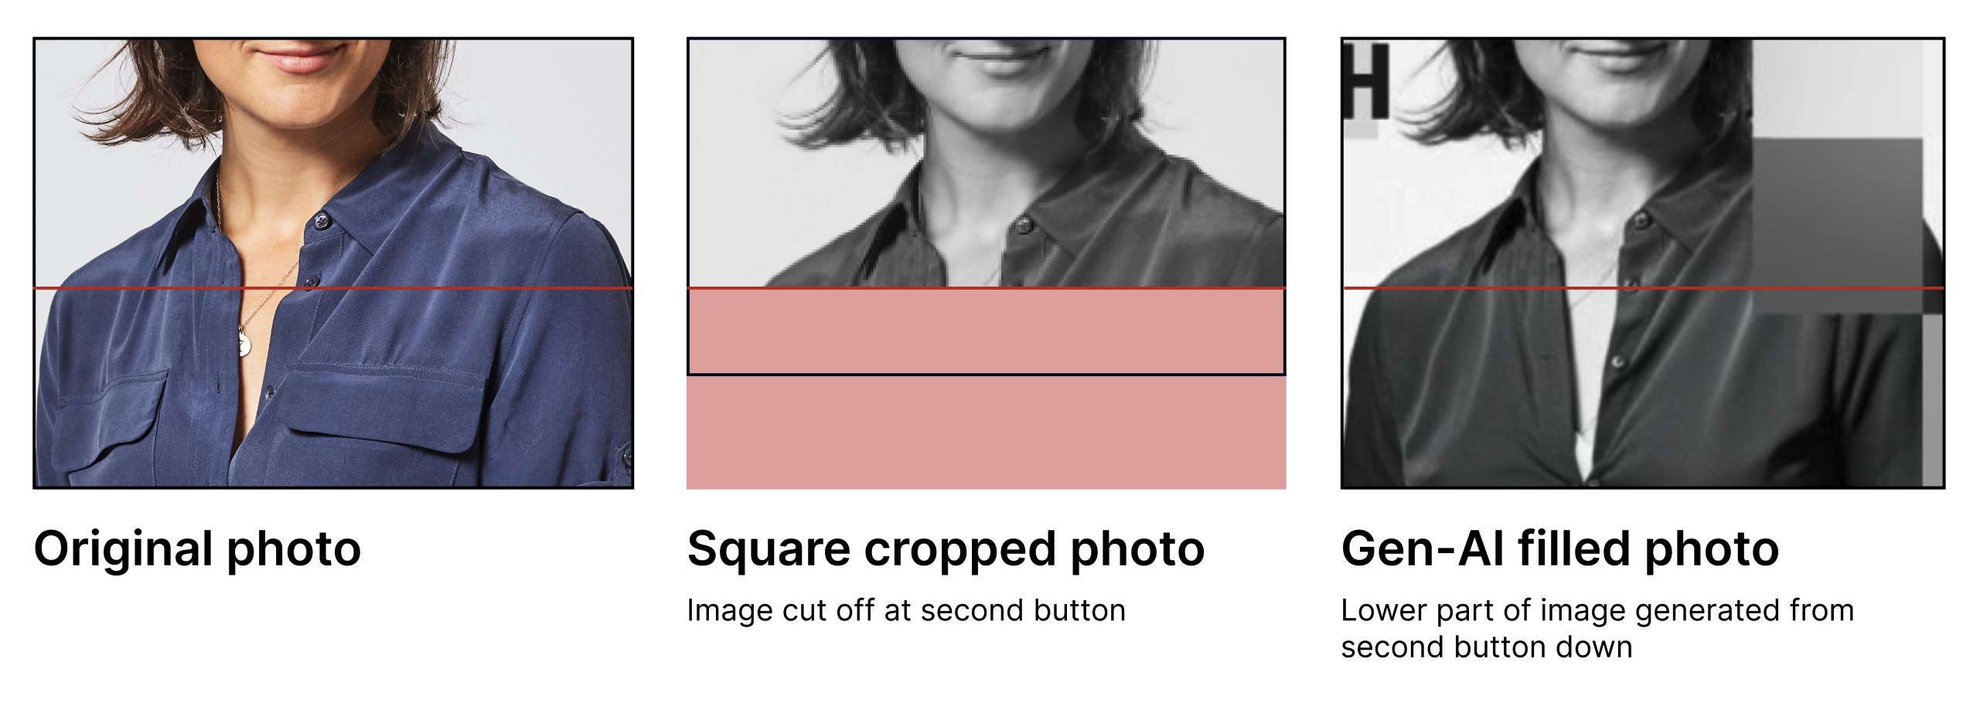
Risks of Generative AI
GenAI is remarkable, but it is not perfect!
HALLUCINATIONS
Hallucinations refer to generated content that is untrue
GenAI models tend to confidently hallucinate

Slide 22
Why do LLMs hallucinate?
Often trained to generate text by predicting the next [masked] word in a sequence based on patterns learned from vast amounts of data, without a true understanding of facts or context.
Probabilistic Nature: LLMs generate text based on statistical correlations between words, not on a fact-checking mechanism.
Lack of Grounding: LLMs lack an inherent connection to external sources of truth, like databases or real-time information.
Training Data Issues: Training data may contain errors, conflicting information, or non-factual text
Prompt Ambiguity: When given ambiguous or incomplete prompts, LLMs may "fill in the blanks" with made-up details that sound plausible.
Generalization Limits: LLMs generalize from the patterns they've seen in training data
With assistance from chatGPT
Notes:
Probabilistic Nature: LLMs generate text based on statistical correlations between words, not on a fact-checking mechanism. They can string together plausible-sounding sentences based on patterns seen during training, but these sentences might not correspond to factual reality.
Lack of Grounding: LLMs lack an inherent connection to external sources of truth, like databases or real-time information. They rely entirely on the data they were trained on, which may be incomplete, outdated, or inaccurate.
Training Data Issues: If the training data contains errors, conflicting information, or non-factual text (e.g., fictional stories or unreliable sources), the model may reproduce these in its outputs. LLMs don't have an intrinsic way of distinguishing between fact and fiction.
Prompt Ambiguity: When given ambiguous or incomplete prompts, LLMs may "fill in the blanks" with made-up details that sound plausible. Without clear guidance, the model attempts to provide a complete answer, sometimes introducing inaccuracies.
Generalization Limits: LLMs generalize from the patterns they've seen in training data, and when asked about topics outside of that domain or too specific, they may produce responses that are not grounded in reality, based purely on linguistic patterns rather than facts.

Slide 23
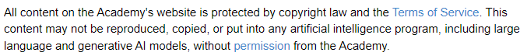
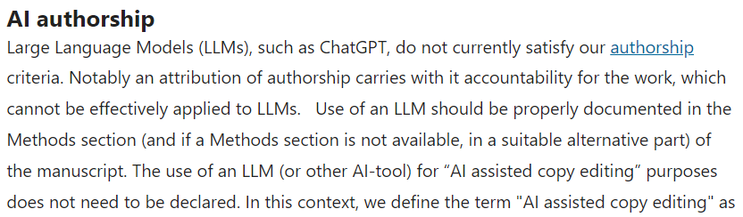
Risks of Generative AI
COPYRIGHT/INTELLECTUAL PROPERTY
EyeWiki disclaimer on training AI models on its content
Can all data on the Internet be used to train GenAI?
Image generation:
Who owns the images generated by GenAI?
Is GenAI just “copying” parts of other images?
Text generation:
Are LLMs authors of scientific publications?
Who is responsible for the information provided by these models?
Nature policy on AI as an author
ENVIRONMENTAL
Carbon emission due to high electricity consumption
Notes:
https://www.nature.com/nature-portfolio/editorial-policies/ai
https://www.scientificamerican.com/article/ais-climate-impact-goes-beyond-its-emissions/

Slide 24
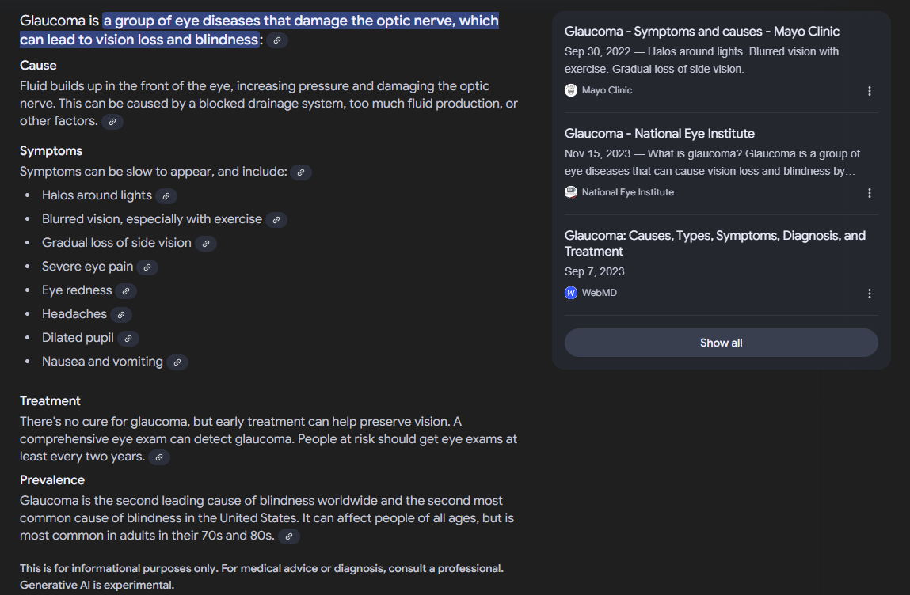
Safeguards
Gemini results for “What is glaucoma?”
How do we reduce the risks posed by GenAI models?
HALLUCINATIONS
Prompt engineering: highly descriptive prompts with clear and detailed instructions
Limitation: what is “clear”? How detailed is “detailed”?
Fine-tuning: fine-tune model on domain data to make it generate more relevant responses
Limitation: does not help if we want to use a model out-of-the-box
Retrieval-Augmented Generation (RAG)
The process of optimizing the output of a large language model, so it references an authoritative knowledge base outside of its training data sources before generating a response
Hallucination detection methods
FactScore computes the “percentage of atomic facts [in a generated text] supported by a given knowledge source” [1]
Kola compares model-generated text with and without including knowledge as part of prompts [2]
Min, Sewon, et al. "FActScore: Fine-grained Atomic Evaluation of Factual Precision in Long Form Text Generation." The 2023 Conference on Empirical Methods in Natural Language Processing.
Yu, Jifan, et al. "KoLA: Carefully Benchmarking World Knowledge of Large Language Models." The Twelfth International Conference on Learning Representations.

Slide 25
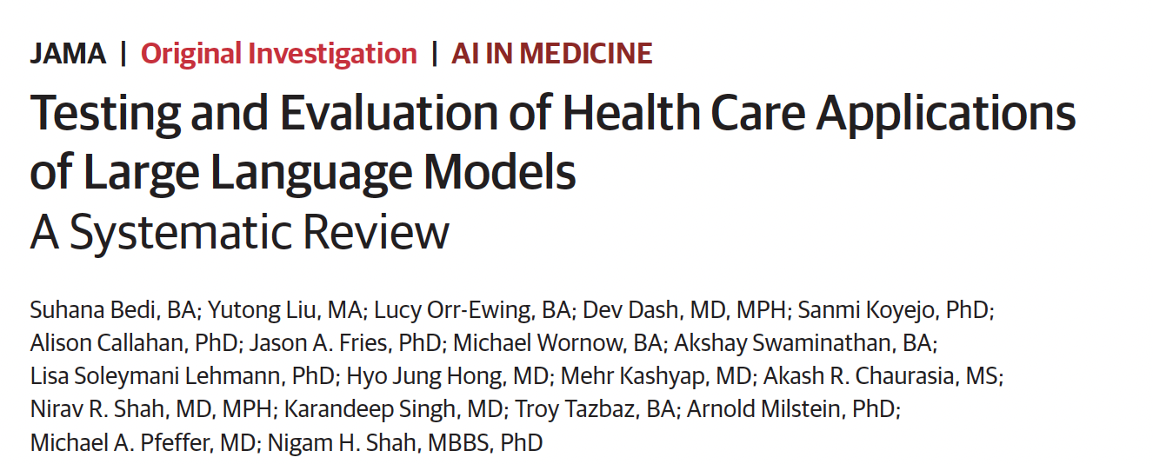
Recent Review of the literature
What is the current state of the art?
LIMITED REAL EVALUATION
Of 519 studies reviewed, published between January 1, 2022, and February 19,2024, only 5% used real patient care data for LLM evaluation
Most (95.4%) used accuracy as the primary dimension of evaluation; fairness, bias, and toxicity (15.8%), deployment considerations (4.6%), and calibration an uncertainty (1.2%) were infrequently measured.
WHAT ARE SOME USES?
most common health care tasks were assessing medical knowledge such as answering medical licensing examination questions (44.5%) and making diagnoses (19.5%). Administrative tasks such as assigning billing codes (0.2%) and writing prescriptions (0.2%) were less studied.
WHAT SPECIALITIES ARE EXPLORING LLMS?
most in generic health care applications (25.6%), internal medicine (16.4%), surgery (11.4%), ophthalmology (6.9%), with nuclear medicine (0.6%), physical medicine (0.4%), and medical genetics (0.2%) being the least represented.
Bedi, et al. 2024

Slide 26

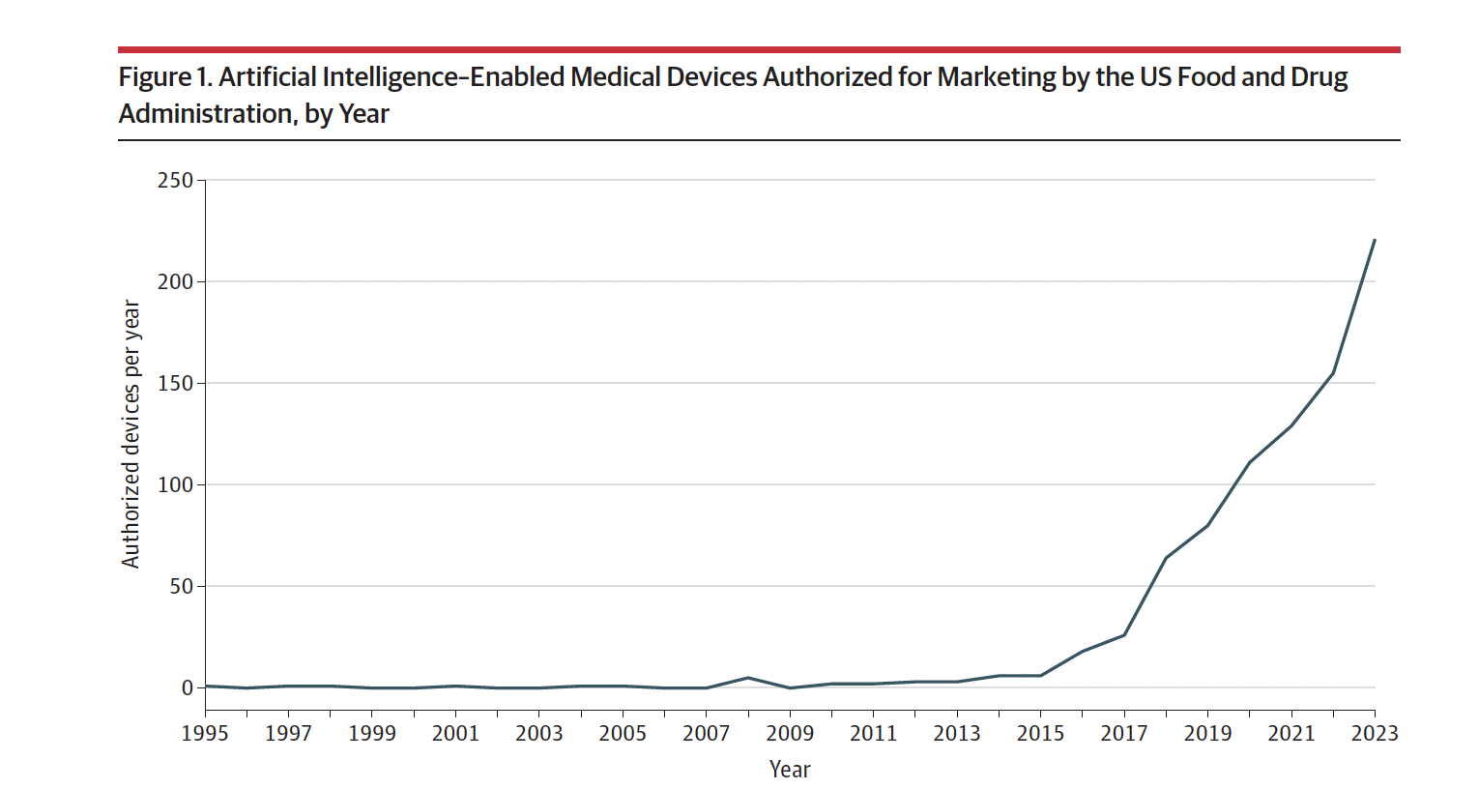
FDA Perspective
CHALLENGES NOTED
Applications of generative AI, such as large language models (LLMs), present a unique challenge because of the potential for unforeseen, emergent consequences; the FDA is yet to authorize an LLM.
Even “AI scribes” meant to summarize medical notes can hallucinate or include diagnoses not discussed in the visit.
The complexity of LLMs and the permutations of outputs necessitate oversight from individuals and institutions in addition to regulatory authorities. Because we cannot unduly burden individual clinicians with such oversight, there is a need for specialized tools that enable better assessment of LLMs in the contexts and settings in which they will be used.
RECOMMENDATIONS
AI performance should be monitored in the environment in which it is being used.
Health systems will need to provide an information eco-system
Warraich, et al. 2024

Slide 27
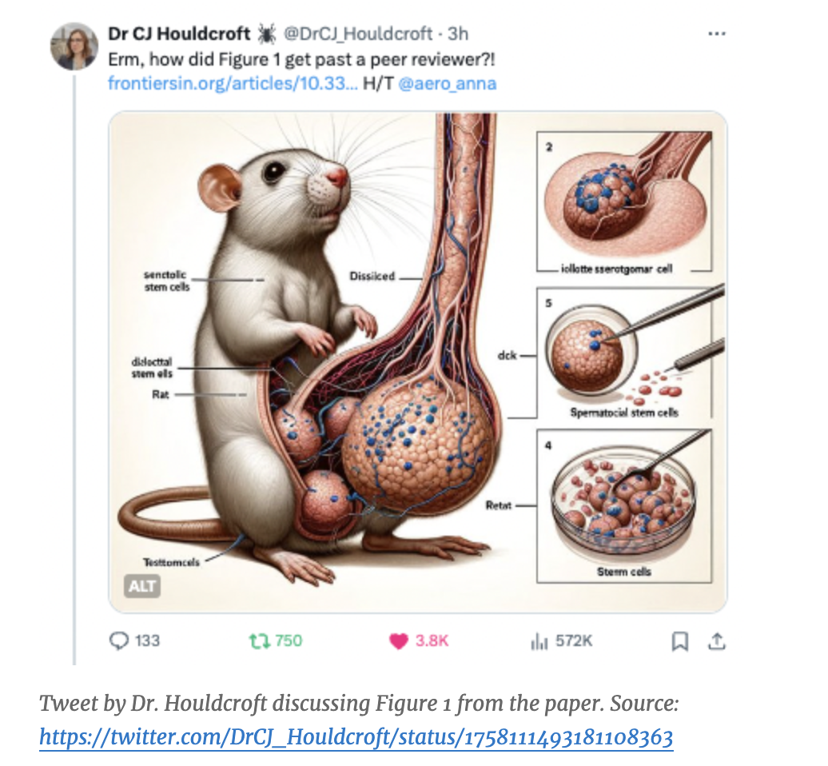
Making the rounds on Twitter (originally published in Frontiers)
Retracted

Slide 28
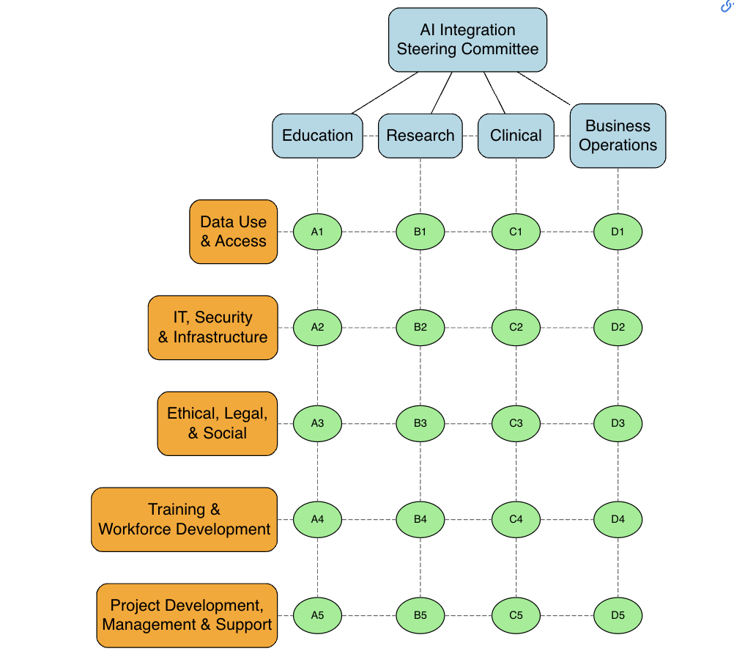
A Proposed Framework for Generative AI
https://seandavi.github.io/campus-llm-kb/framework.html#fig-framework

Slide 29
Proposed Guiding Principles
LLMs must be used in a manner consistent with the mission, vision, and values of the academic hospital system.
The use of LLMs must align with relevant legal and regulatory requirements, including but not limited to data privacy, security, and intellectual property laws.
The deployment of LLMs should prioritize patient safety, privacy, and wellbeing.
LLMs must be used in a transparent manner, with users understanding the capabilities and limitations of the technology.
Continuous improvement and evaluation of LLM usage should be prioritized to ensure ongoing alignment with organizational goals.

Slide 30


Set up
GitHub repo with files/notebooks:
https://github.com/QTIM-Lab/ARVO25_AI4Oph
https://tinyurl.com/arvoTutorial
GitHub

Slide 31
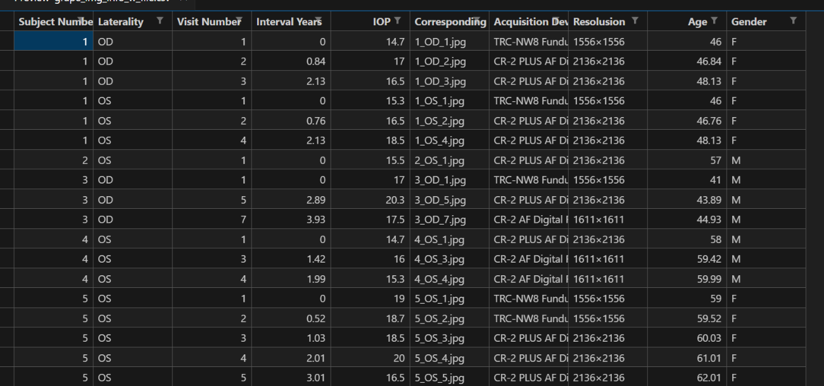
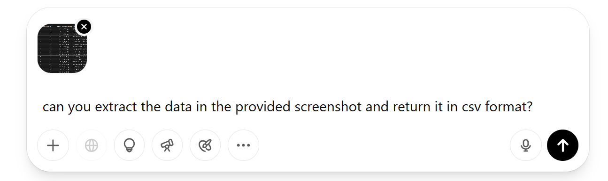
Exercise 1: Using ChatGPT to extract data from a screenshot
Dataset: GRAPE
Open chatgpt.com
Prompt: “can you extract the data in the provided screenshot and return it in csv format?”

Slide 32
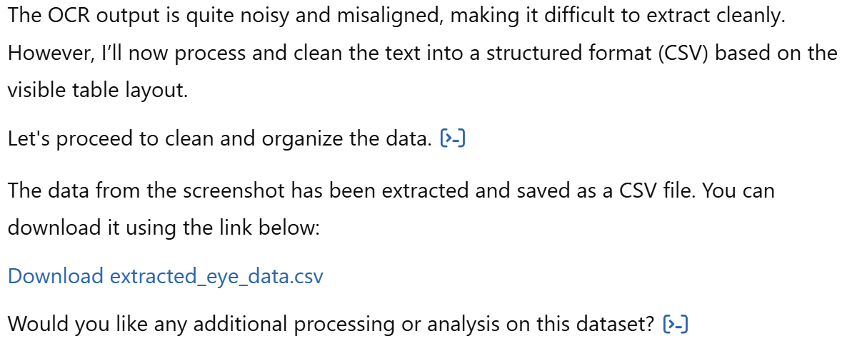
Exercise 1: Using ChatGPT to extract data from a screenshot

Slide 33
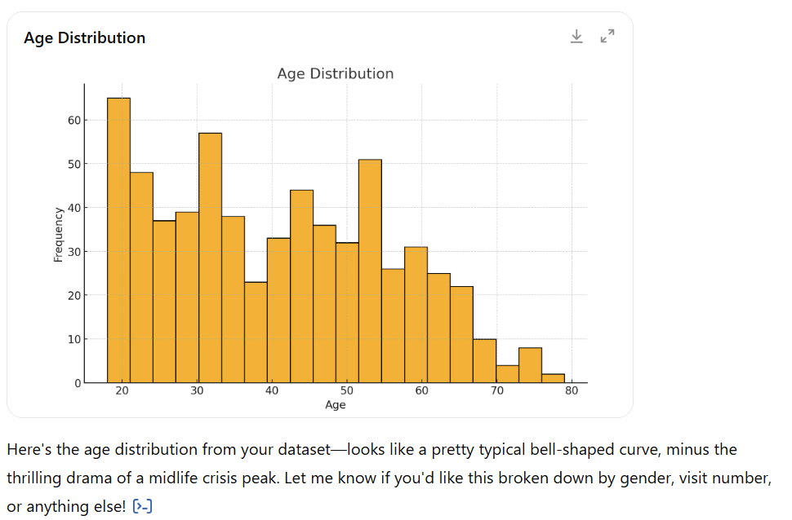
Exercise 2: Data analysis - plotting
Dataset: GRAPE
Open chatgpt.com
Prompt: “given the provided csv file, can you plot the age distribution?”

Slide 34
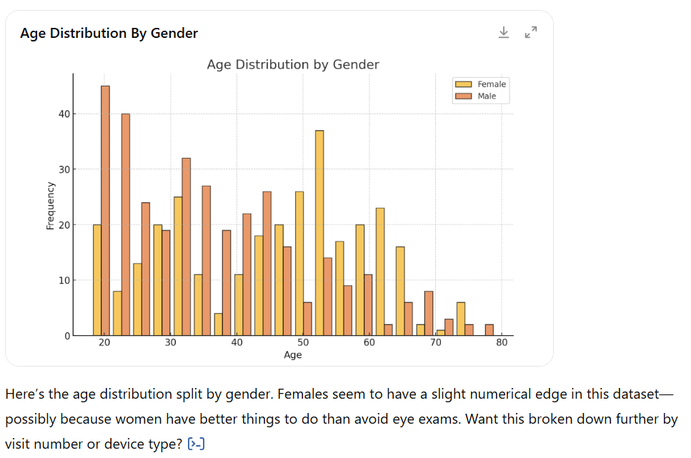
Exercise 2: Data analysis - plotting
Further separate by gender

Slide 35
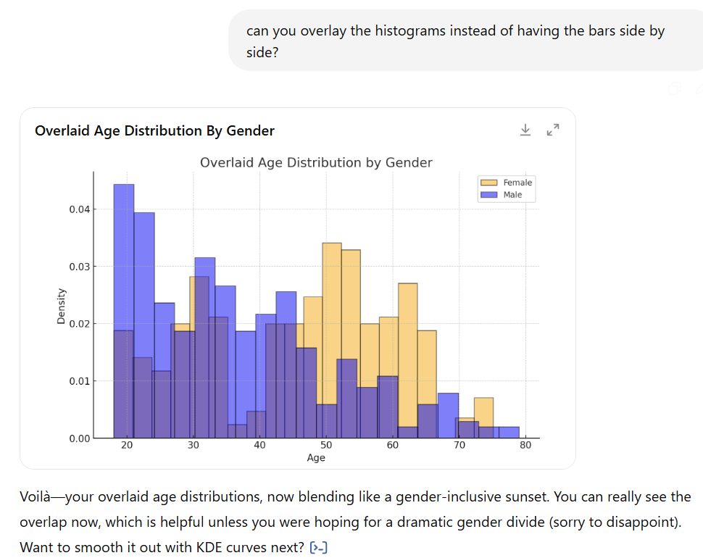
Exercise 2: Data analysis - plotting
Modify plot appearance

Slide 36
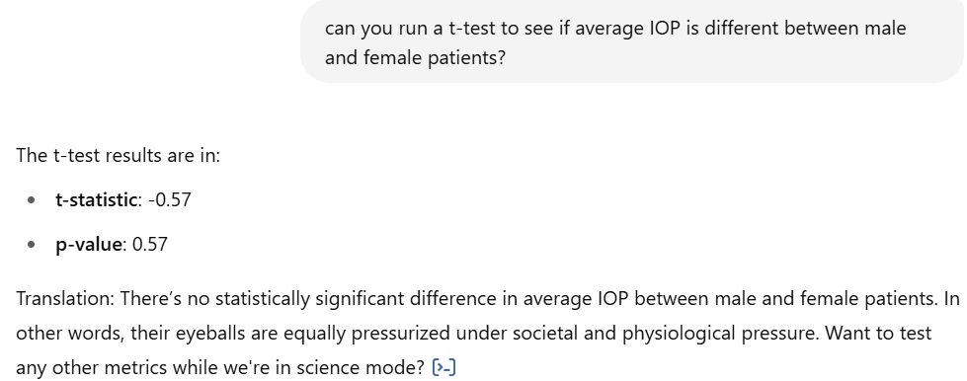
Exercise 2: Data analysis – statistical tests
Run t-test on IOP between male and female patients

Slide 37
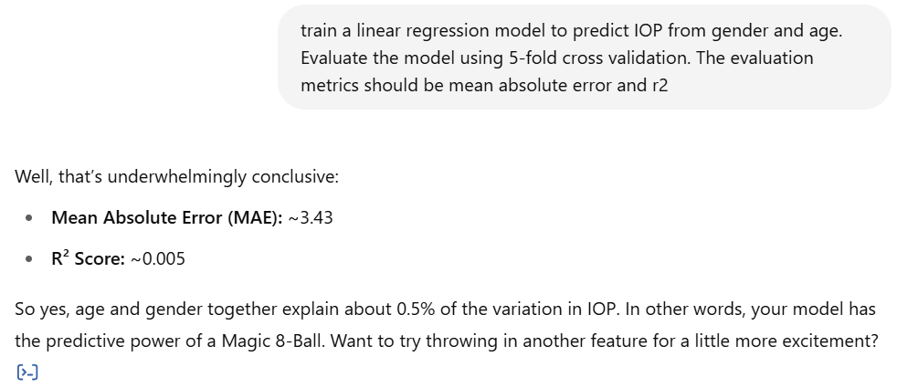
Exercise 2: Data analysis – regression
Train a linear regression model to predict IOP from demographic variables:
Gender
Age
Run 5-fold cross validation
Evaluate using
Mean Absolute Error
R2 score

Slide 38
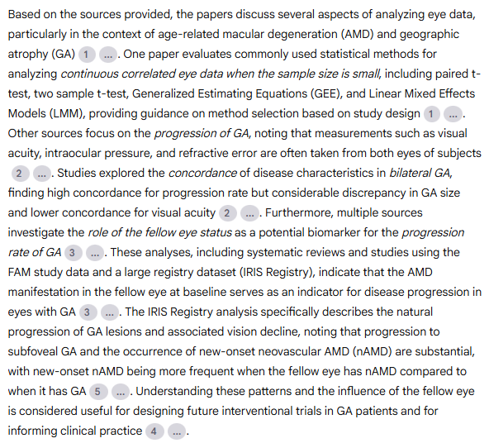
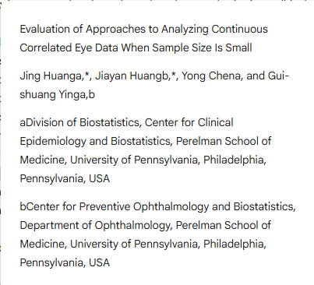
Exercise 3: Using NotebookLM
Data: list of 5 papers related to the role of the fellow eye in Geographic Atrophy patients
Overall task: help the researcher understand what is currently known on the topic and formulate new research questions
“can you provide a paragraph summarizing the uploaded papers?”

Slide 39
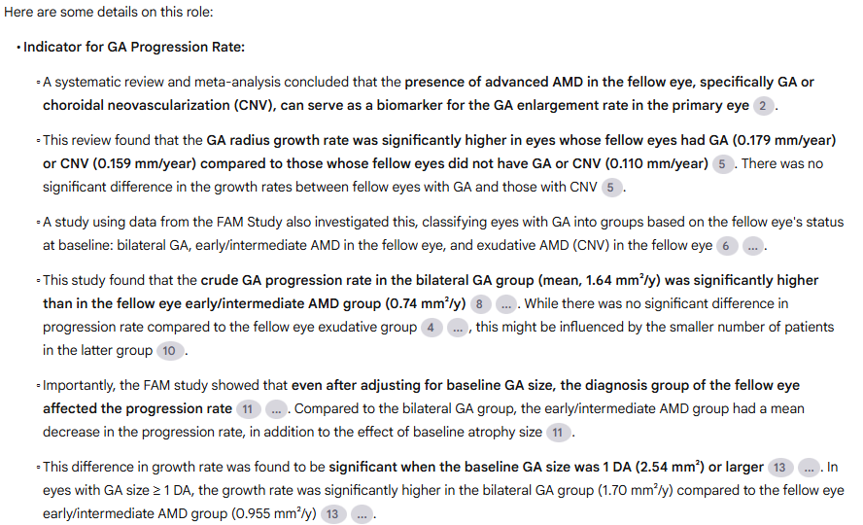
Exercise 3: Using NotebookLM
“can you go into more details on the role of the fellow eye status as a potential biomarker for the progression rate of GA?“

Slide 40
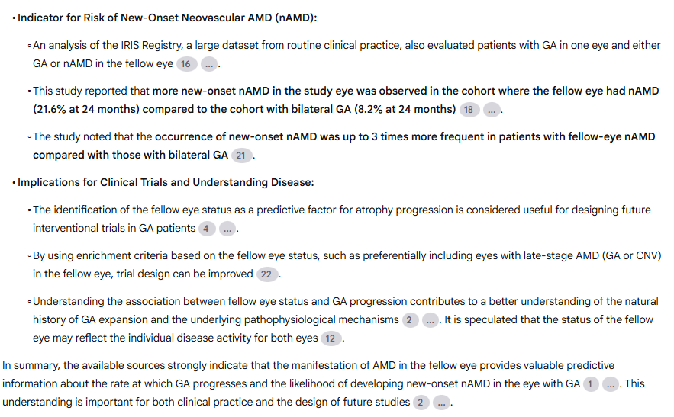
Exercise 3: Using NotebookLM
“can you go into more details on the role of the fellow eye status as a potential biomarker for the progression rate of GA?“

Slide 41
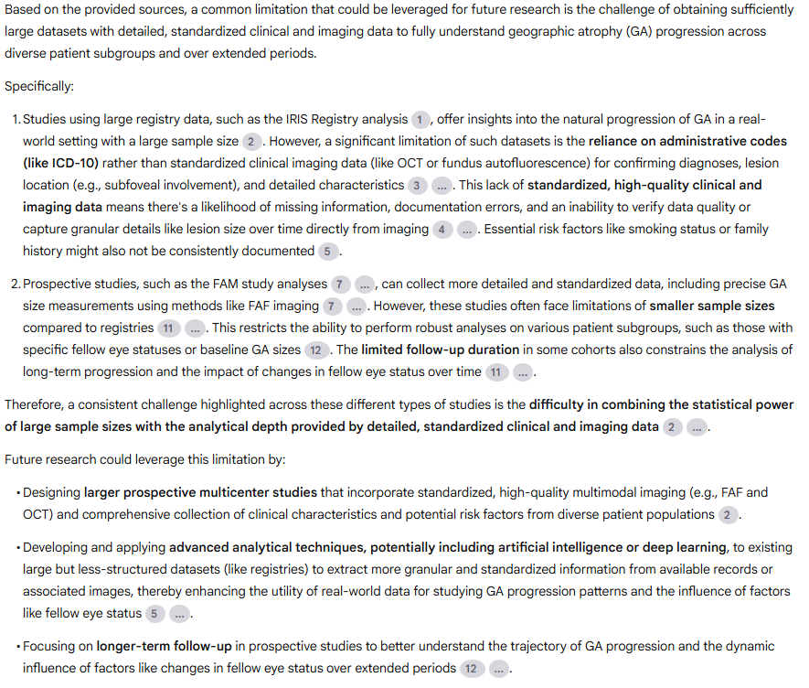
Exercise 3
“can you identify one common limitation of these studies that could be leveraged for future research?”

Slide 42
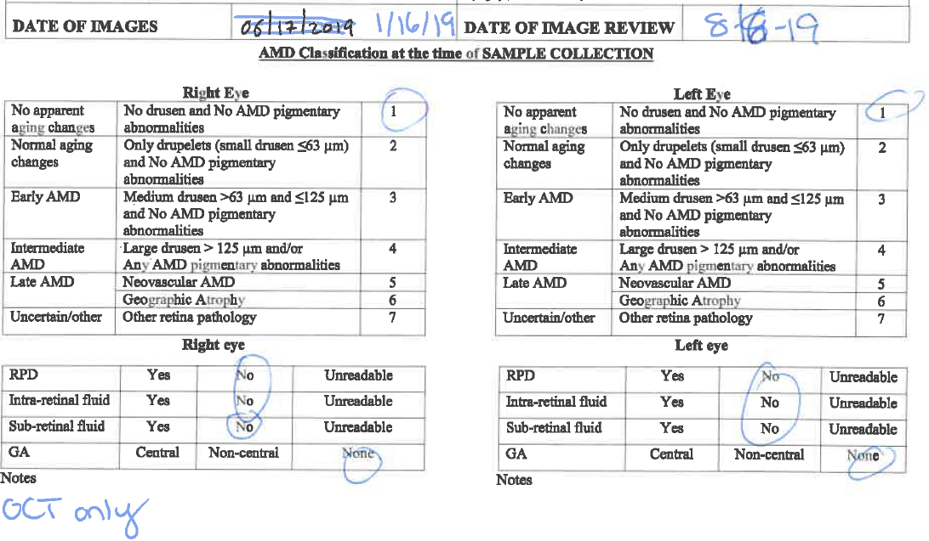
Exercise 3: Using NotebookLM
Extract information from a manually filled-out form
Go to https://notebooklm.google.com/
Upload file “filled_out_form.pdf” from files/ folder

Slide 43


Exercise 3: Using NotebookLM
“What is the image date?”
“what is the AMD classification for the right eye?”

Slide 44

Exercise 3: Using NotebookLM
“can you extract all the selected variables for the right eye and display them in csv format?“

Slide 45

THANK YOU

